Slide 1
Ensemble Methods:
Bagging & Boosting
Portions adapted from slides of David Kauchak, Lev Reyzin, Pierre Geurts, and Max Welling

Slide 2
Ensemble Learning
Basic idea: if one classifier works well, why not use multiple classifiers!

Slide 3
Ensemble Learning
Basic idea: if one classifier works well, why not use multiple classifiers!
Training
learning alg
model 1
learning alg
model 2
Training
Data
…
learning alg
model m

Slide 4
Ensemble Learning
Basic idea: if one classifier works well, why not use multiple classifiers!
Testing
model 1
prediction 1
example to label
model 2
prediction 2
How do we decide on the final prediction?
…
model m
prediction m

Slide 5
Ensemble Learning
Basic idea: if one classifier works well, why not use multiple classifiers!
Testing
take majority vote
if they output probabilities, take a weighted vote
prediction 1
prediction 2
…
How does having multiple classifiers help us?
prediction m

Slide 6
Benefits of Ensemble Learning
Assume each classifier makes a mistake with some probability (e.g. 40%)
model 1
Assuming the decisions made between classifiers are independent, what will be the probability that we make a mistake (i.e. error rate) with three classifiers for a binary classification problem?
model 2
model 3

Slide 7
Benefits of Ensemble Learning
Assume each classifier makes a mistake with some probability (e.g. 40%)
model 1 | model 2 | model 3 | prob
C | C | C | .6*.6*.6=0.216
C | C | I | .6*.6*.4=0.144
C | I | C | .6*.4*.6=0.144
C | I | I | .6*.4*.4=0.096
I | C | C | .4*.6*.6=0.144
I | C | I | .4*.6*.4=0.096
I | I | C | .4*.4*.6=0.096
I | I | I | .4*.4*.4=0.064

Slide 8
Benefits of Ensemble Learning
Assume each classifier makes a mistake with some probability (e.g. 40%)
model 1 | model 2 | model 3 | prob
C | C | C | .6*.6*.6=0.216
C | C | I | .6*.6*.4=0.144
C | I | C | .6*.4*.6=0.144
C | I | I | .6*.4*.4=0.096
I | C | C | .4*.6*.6=0.144
I | C | I | .4*.6*.4=0.096
I | I | C | .4*.4*.6=0.096
I | I | I | .4*.4*.4=0.064
0.096+
0.096+
0.096+
0.064 =
35% error!

Slide 9
Benefits of Ensemble Learning
m classifiers
r = probability of mistake for individual classifier
r | p(error) 3 classifiers | p(error) 5 classifiers
0.4 | 0.35 | 0.32
0.3 | 0.22 | 0.16
0.2 | 0.10 | 0.06
0.1 | 0.028 | 0.0086
0.05 | 0.0073 | 0.0012

Slide 10
Given enough classifiers…
r = 0.4

Slide 11
Obtaining independent classifiers
learning alg
model 1
learning alg
model 2
Training
Data
…
learning alg
model m
Where to we get m independent classifiers?

Slide 12
Idea 1: different learning methods
model 1
decision tree
learning alg
k-nn
learning alg
model 2
Training
Data
perceptron
…
svm
model m
gradient descent variant 1
learning alg
gradient descent variant 2
Pros/cons?
…

Slide 13
Idea 1: different learning methods
Pros:
  Lots of existing classifiers already
  Can work well for some problems
Cons/concerns:
  These classifiers are not independent
    e.g. many of these classifiers are linear models
    They make the same mistakes!
      voting won’t help

Slide 14
Idea 2: split up training data
part 1
learning alg
model 1
part 2
learning alg
model 2
Training
Data
…
…
part m
learning alg
model m
Use the same learning algorithm, but train on different parts of the training data

Slide 15
Idea 2: split up training data
Pros:
  Learning from different data, so reduce overfitting to same examples
  Easy to implement
  Fast
Cons/concerns:
  Each classifier only trains on a small amount of data
  Not clear if it is better than training on full data with regularization

Slide 16
Idea 3: Bagging
Training
Data 1
learning alg
model 1
…
Training
Data
…
learning alg
model m
Training
Data m

Slide 17

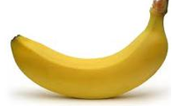
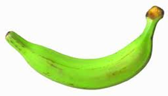
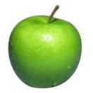
Data-Generating Distribution
Training data
Test set
data generating distribution

Slide 18
Ideal Situation
Training data 1
Training data 2
…
data generating distribution
Notes:
but we can’t do this ☹

Slide 19
Training Data as Proxy
“Training” data 1
“Training” data 2
…
Training data
Use training data as a proxy for the data generating distribution
Notes:
pretend like the training data defines out data generating distribution
sample with replacement to generate new “training” data sets

Slide 20
Sampling with Replacement
“Training” data 1
pick a random example from the real training data
Training data

Slide 21
Sampling with Replacement
“Training” data 1
add it to the new “training” data
Training data

Slide 22
Sampling with Replacement
“Training” data 1
put it back (i.e. leave it) in the original training data
Training data

Slide 23
Sampling with Replacement
“Training” data 1
pick another random example
Training data

Slide 24
Sampling with Replacement
“Training” data 1
pick another random example
Training data

Slide 25
Sampling with Replacement
“Training” data 1
keep going until you’ve created a new “training” data set
Training data

Slide 26
Sampling with Replacement
“Training” data 1
“Training” data 2
…
Make more training sets
Training data
Notes:
pretend like the training data defines out data generating distribution
sample with replacement to generate new “training” data sets

Slide 27
Bagging (Bootstrap AGGregatING)
Create m “new” training sets
  sampling with replacement from the original training data set
  called m “bootstrap” samples
Train a classifier on each of these data sets
Classification: take the majority vote from the m classifiers

Slide 28
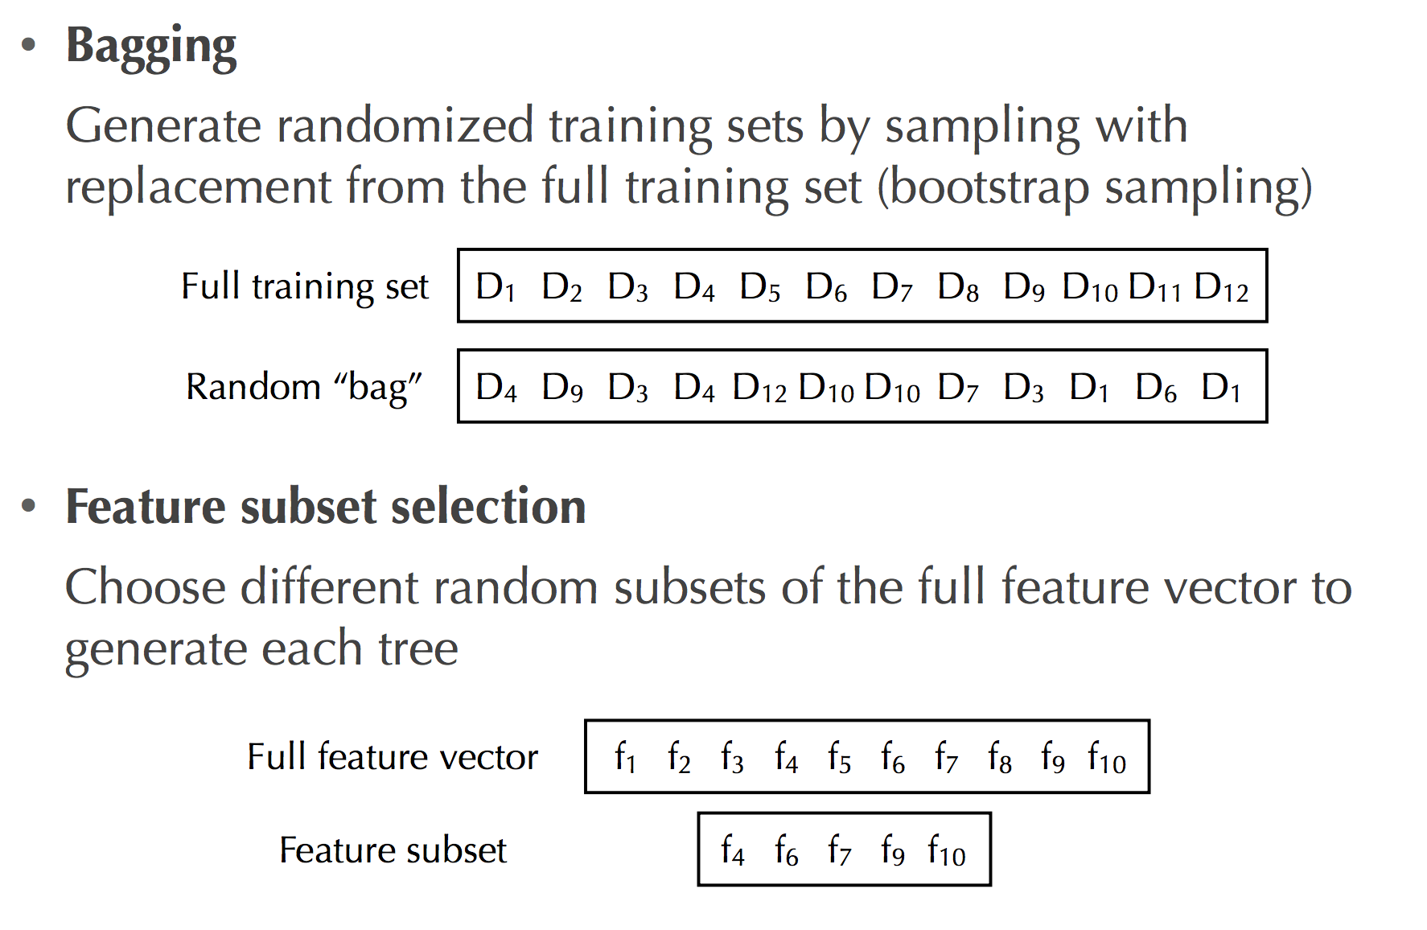
Random Forests
Perhaps we’re taking this tree metaphor too far!
Method: Grow many decision trees (DT) on bootstrap samples
  Bootstrap sampling
  For each boostrap sample, grow a DT w/ random feature subset selection
  Aggregate (vote or average) the predictions of DTs for a new query

Slide 29
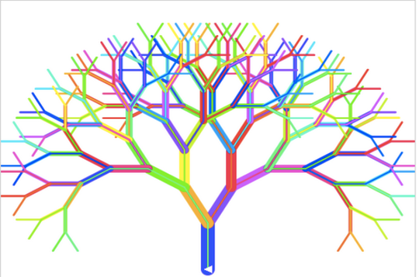
Random Forests
Typically 5 – 100 trees
  Often only a few are needed
# of rand. attributes often doesn’t matter much
  Common value: sqrt(numAttributes)
Trees are fast to generate
  Fewer attributes to test per split
  No pruning
Training / Validation Error:
  For each example, find trees that didn’t use that data
  Test performance using this sub-ensemble of trees

Slide 30
Random Forests
Method | E | Bias | Variance
Full Decision Tree | 10.2 | 3.5 | 6.7
Random Forest (d=10) | 5.3 | 3.8 | 1.5
Random Forest (d=7) | 4.8 | 3.8 | 1.0
Random Forest (d=5) | 4.9 | 4.0 | 0.9
Random Forest (d=3) | 5.6 | 4.7 | 0.8
d is the # of attributes considered each round
  The smaller d, the greater the reduction of variance but also the higher the increase of bias
Random Forests are powerful classifiers!

Slide 31
Bagging Concerns
Training
Data 1
Won’t these all be basically the same?
Training
Data
…
Training
Data m

Slide 32
Bagging Concerns
For a data set of size n, what is the probability that a given example will NOT be selected in a “new” training set sampled from the original?
Training data

Slide 33
Bagging Concerns
What is the probability it isn’t chosen the first time?
Training data

Slide 34
Bagging Concerns
What is the probability it isn’t chosen any of the n times?
Each draw is independent and has the same probability
Training data

Slide 35
probability of overlap
Converges very quickly to 1/e ≈ 37%

Slide 36
bagging overlap
Training
Data 1
Won’t these all be basically the same?
Training
Data
…
On average, a randomly sampled data set will only contain ~63% of the examples in the original
Training
Data m

Slide 37
When does bagging work?
If the classifiers make independent errors, then ensemble can improve performance
  Similar bias as single predictor, but the variance is reduced
By voting, the classifiers are more robust to noisy examples
Bagging is most useful for classifiers that are:
  Unstable: small changes in the training set produce very different models
  Prone to overfitting
Often has similar effect to regularization
Notes:
which methods that we’ve seen so far are more unstable?
decision trees

Slide 38
Ensemble Learning #2: Boosting
Basic idea: if one classifier works well, why not use multiple classifiers!
Training
learning alg
model 1
learning alg
model 2
Training
Data
…
learning alg
model m

Slide 39
Boosting (Main Idea)
Train classifiers (e.g., small decision trees) in a sequence
  Each new classifier should focus on those cases which were incorrectly classified in the last round
  Combine the predictions of classifiers
    Similar to bagging
  Each classifier should be very “weak”

Slide 40

“Strong” learner
Given
a “reasonable” amount of training data
a target error rate ε
a failure probability p
A strong learner will produce a classifier with error rate <ε with probability 1-p

Slide 41

“Weak” learner
Given
a “reasonable” amount of training data
a failure probability p
A weak learning algorithm will produce a classifier with error rate < 0.5 with probability 1-p
Weak learners are much easier to create!

Slide 42
Boosting Intuition
We adaptively weigh each data case
Data cases which are wrongly classified get high weight
Each boosting round learns a new (simple) classifier on the weighted dataset
These classifiers are weighted to combine them into a single powerful classifier
Classifiers that that obtain low training error rate have high weight
We stop by using monitoring a hold out set (cross-validation)

Slide 43
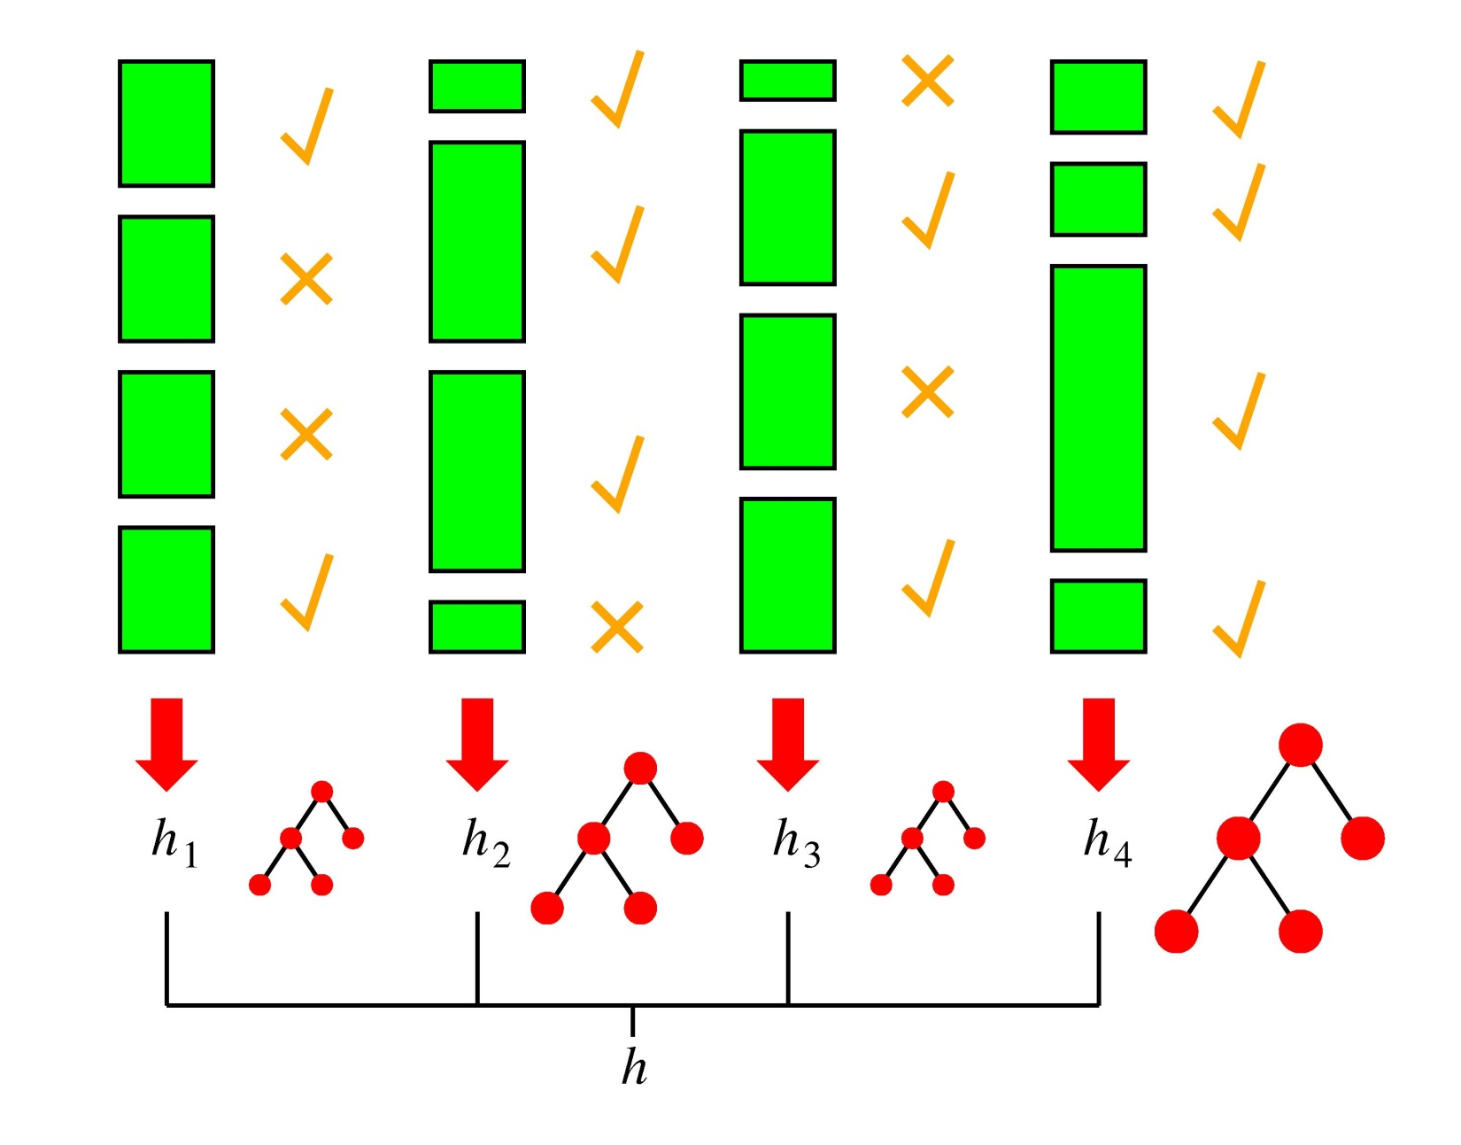
Boosting in a Picture
boosting rounds
training cases
correctly
classified
training case
has large weight
in this round
this DT has
a strong vote.

Slide 44
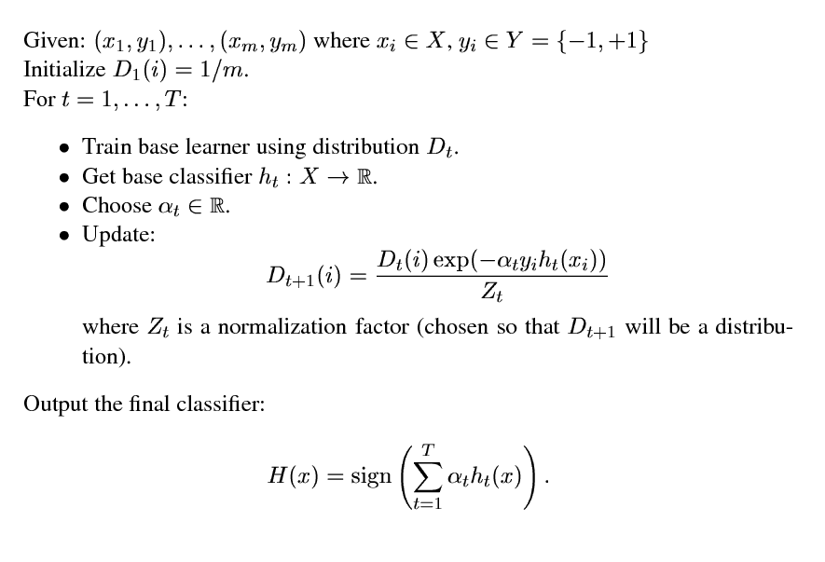

Adaboost
AdaBoost

Slide 45
Adaboost
Have we seen this before?

Slide 46
AdaBoost justification
update the example weights
Exponential loss!
AdaBoost turns out to be another approach for minimizing the exponential loss!

Slide 47
Other Boosting Variants
Adaboost =
Logitboost
Loss
Brownboost
0-1 loss
loss
Mistakes
Correct
Notes:
- many other “boosting” variants besides AdaBoost that can all be equated to different surrogate loss functions

Slide 48
Boosting example
weak learner = linear classifier
Start with equal weights
What would be the best linear classifier learned on this data set?

Slide 49
Boosting example
How should we reweight examples?

Slide 50
Boosting example
reds on this side get less weight
blues on this side get more weight
reds on this side get more weight
blues on this side get less weight

Slide 51
Boosting example
How should we reweight examples?

Slide 52
Boosting example
What would be the best line learned on this data set?

Slide 53
Boosting example

Slide 54
Boosting example
f₁
f₂
f₄
f₃
The strong (nonlinear) classifier is built as the combination of all the weak (linear) classifiers.

Slide 55
Boosting Example
Boosting reduces the bias but increases the variance
In this example, variance was already low
  Bagging didn’t help as much as boosting
Method | E | Bias | Variance
Full Decision Tree | 11.7 | 8.8 | 2.9
+ Boosting (T=50) | 6.4 | 1.7 | 4.7
+ Bagging (T=50) | 9.1 | 8.7 | 0.4

Slide 56
Boosting Recap
Main decision is choice of weak learner
  This affects:
    Training time
    Evaluation time
    Intuitiveness of model
Common choices for weak learners
  CART
  Decision stumps
  SVM (Can be considered weak in certain cases)

Slide 57
Ensemble Methods
Compared to basic decision trees, what do we lose by using ensemble methods?
  Efficiency & interpretability
However…
  Variable importance can still be computed
    Slightly more involved (e.g., by averaging over all trees)
  Combining techniques can be parallelized and boosting methods use smaller trees
    So, the increase of computing times can be handled

Slide 58
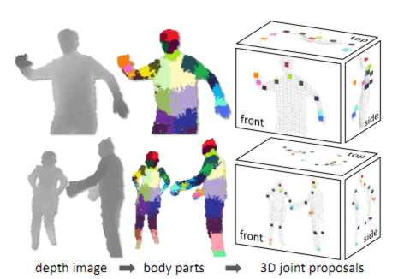
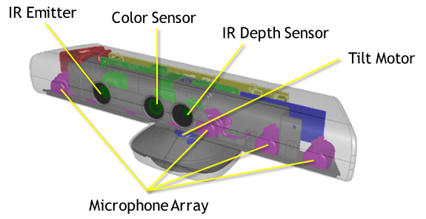
Ensemble Methods in Practice
Adaboost with trees is a good “off-the-shelf” classification method
Random Forests are widely used to win Kaggle competitions
MS Kinect uses Random
Forests to predict joint
locations from depth
map

Slide 59
Recap
Bias and variance are very useful to predict how changing the (learning and problem) parameters will affect the accuracy
  This explains why simple methods can work better than complex ones on very difficult tasks
Variance reduction is a very important topic:
  To reduce bias is easy, but to keep variance low is not as easy
Ensemble methods are very effective techniques to reduce bias and/or variance

